Slide 1
Statistics

Slide 2
Contents
Statistics Basics
What are Statistics?
How to estimate a parameter?
How to obtain sample data?
Statistics Measures

Slide 3
Statistics Basics
Statistics is a tool for converting raw data into information.
STATISTICS
INFORMATION
DATA

Slide 4
Statistics Basics
But where then does the data come from?
How is it gathered?
How do we ensure its accurate?
Is the data reliable?
Is it representative of the population from which it was drawn?
We now explore some of these issues.

Slide 5
What are Statistics ?
Statistics are the numbers you always see on the news and in the paper.
Statistics are useful when trying to prove a point or trying to scare you
but what are they?
To answer this question, we need to talk about why we
even measure them in the first place.
The goal of this field is to try to explain and
model the world around us.

Slide 6
What are Statistics ?
To do that, we have to take a look at the population.
Population - definition
is the entire pool of subjects of an experiment or a model.
Essentially, your population is who you care about .
Who are you trying to talk about?
Egs:
If you are trying to test if smoking leads to heart disease, your population would be the smokers of the world.
If you are trying to study teenage drinking problems, your population would be all teenagers.

Slide 7
What are Statistics ?
Now, consider that you want to ask a question about your population,
for example:
if your population is all of your employees (assume that you have over 1,000 employees),
perhaps you want to know what percentage of them smoke.
The question is called a parameter.

Slide 8
What are Statistics ?
Parameter – Definition
as a numerical measurement describing a characteristic of a population.
For example,
if you ask all 1,000 employees and 100 of them smoke, the rate of smoking is 10%.
The parameter here is 10%.
However, practically you probably can't ask every single employee whether they smoke.

Slide 9
What are Statistics ?
What if there are over 10,000 employees in the company?
It would be very difficult to track everyone down in order to get your answer.
When this happens, it's impossible to figure out this parameter.
In this case, we can estimate the parameter.

Slide 10
How to estimate the parameter?
First, we will take a sample of the population.
Sample of a population - Definition
as a subset (random not required) of the population.
Probably, we ask 200 of the 1,000 employees we have.
Of these 200, suppose 26 employees smoke, making the smoking rate 13%.
Here, 13% is not a parameter
since we didn't get a chance to ask everyone.

Slide 11
How to estimate the parameter?
This 13% is an estimate of a parameter.
Do you know what that's called?
That's right, a statistic!
Statistic - defined
a numerical measurement describing a characteristic of a sample of a population

Slide 12
How to estimate the parameter?
A statistic is just an estimation of a parameter.
A number that attempts to describe an entire population
by describing a subset of that population.
necessary because you can never hope to give a survey to every single teenager or
to every single smoker in the world.
That's what the field of statistics is all about—
taking samples of populations and running tests on these samples.

Slide 13
How to estimate the parameter?
A statistic is just an estimation of a parameter.
A number that attempts to describe an entire population
by describing a subset of that population.
Statistics is necessary because you can never hope to give a survey to every single teenager or
to every single smoker in the world.
That's what the field of statistics is all about—
taking samples of populations and running tests on these samples.

Slide 14
How to estimate the parameter?
Remember !!!
When you are given a statistic,
the number only represents a sample of that population,
not the entire pool of subjects.

Slide 15
How do we obtain sample data?
Obtaining/Collecting data or samples
Two ways
Observational
Experimentation
Both have their pros and cons, of course.
They produce different types of behavior
Hence, need different types of analysis.

Slide 16
How do we obtain sample data?
Observational
Obtaining data by means of measuring specific characteristics
but not attempting to modify the subjects being studied.
For example :
you have a tracking software on your website
that observes users' behavior on the website
such as length of time spent on certain pages
and the rate of clicking on ads
all the while not affecting the user's experience,
then that would be an observational study.

Slide 17
How do we obtain sample data?
one of the most common ways to get data because it's just plain easy.
All you have to do is observe and collect data.
Observational studies are also limited in the types of data being collected.
because the observer (you) is not in control of the
environment.
You may only watch and collect natural behavior.
If you are looking to induce a certain type of behavior
an observational study would not be useful.

Slide 18
How do we obtain sample data?
Experimentation
An experiment consists of a treatment and the observation of its effect on the subjects.
Subjects in an experiment are called experimental units.
This is usually how most scientific labs collect data.
They will put people into two or more groups (usually just two)
and call them the control and the experimental group.
The control group is exposed to a certain environment and then observed.

Slide 19
How do we obtain sample data?
The experimenter then aggregates data from both the groups
and makes a decision about which environment was more favorable (favorable is a quality that the experimenter gets to decide).

Slide 20
How do we obtain sample data?
The experimenter then aggregates data from both the groups
and makes a decision about which environment was more favorable (favorable is a quality that the experimenter gets to decide).

Slide 21
How do we obtain sample data?
Sampling data
statistics are the result of measuring a sample of a population
two very common ways to decide who gets the honor of being in the sample that we measure
main type of sampling is the random sampling,
the most common way to decide the sample sizes and the sample members.

Slide 22
How do we obtain sample data?
Probability Sampling
a way of sampling from a population
in which every person has a known probability of being chosen
but that number might be a different probability than another user.
The simplest and most common probability sampling method is random sampling.

Slide 23
How do we obtain sample data?
Random Sampling
A marketing example
consider that we expose half of our users to a certain landing page
with certain images and a certain style (website A)
and we measure whether or not they sign up for the service.

Slide 24
How do we obtain sample data?
Random Sampling
Then, we expose the other half to a different landing page,
different images, and different styles (website B)
and again measure whether or not they sign up.
We can then decide which of the two sites performed better and should be used going further.
This, specifically, is called an A/B test..

Slide 25
How do we obtain sample data?
Suppose that we are running an A/B test and need to figure out who will be in group A and who will be in group B.
There are the following three suggestions from the data team:
Separate users based on location: Users on the west coast are placed in group A, while users on the east coast are placed in group B
Separate users based on the time of day they visit the site: Users who visit between 7 p.m. and 4 a.m. get site A, while the rest are placed in group B
Make it completely random: Every new user has a 50/50 chance of being placed in either group

Slide 26
How do we obtain sample data?
The first two are valid options for choosing samples
simple to implement,
but both have one fundamental flaw:
both are at the risk of introducing a sampling bias.
Sampling bias occurs when the way the sample is obtained systemically favors some outcome over the target outcome.
If we chose our groups based on where they live or what time they log in,
we are priming our experiment incorrectly and, now, we have much less control over the results.

Slide 27
How do we obtain sample data?
Chances of introducing confounding factors into the analysis – not good
A confounding factor is a variable that we are not directly measuring
but connects the variables that are being measured.
a confounding factor is like the missing element in the analysis that is invisible but affects our results.
In this case, option 1 is not taking into account the potential confounding factor of geographical taste.
For example, if website A is unappealing, in general, to the west coast users, it will affect your results drastically.

Slide 28
How do we obtain sample data?
Similarly, option 2 might introduce a temporal (time-based) confounding factor.
What if website B is better viewed in a nighttime environment (which was reserved
for A),
and users are turned off to the style purely because of what time it is.
These are both factors that we should avoid,
so, go with option 3, which is a random sample.

Slide 29
How do we obtain sample data?
A random sample is chosen such that every single member of a population
has an equal chance of being chosen as any other member.
Everyone has the exact same chance of being in any particular group.
Random sampling is an effective way of reducing the impact of confounding factors.

Slide 30
How do we obtain sample data?
Unequal Probability Sampling
Different probabilities for different potential sample members.

Slide 31
Statistic Measures
Once we have samples, we need to quantify the results.
Suppose we wish to generalize the happiness of the employees
or we want to figure out whether salaries
in the company are very different from person to person.
These are some common ways of measuring our results.

Slide 32
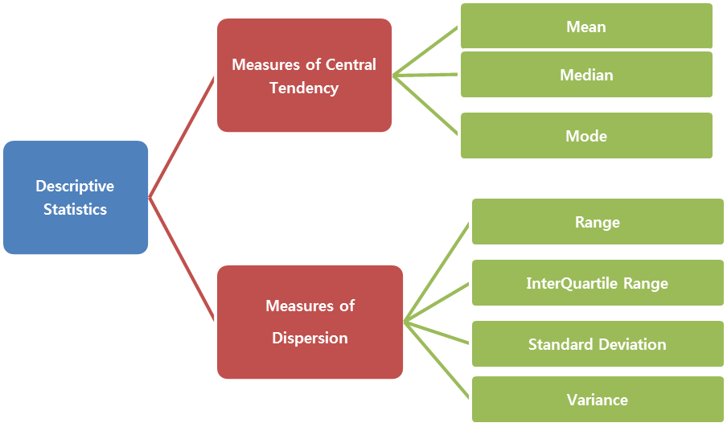
Statistic Measures

Slide 33
Statistic Measures
Measures of center
Middle or center of a dataset
Required to make generalizations about data values
Eg: average rainfall at a place, average marks scored by a student, average height of Males/females in a community
Generalization helps to convey the information easily about a large dataset

Slide 34
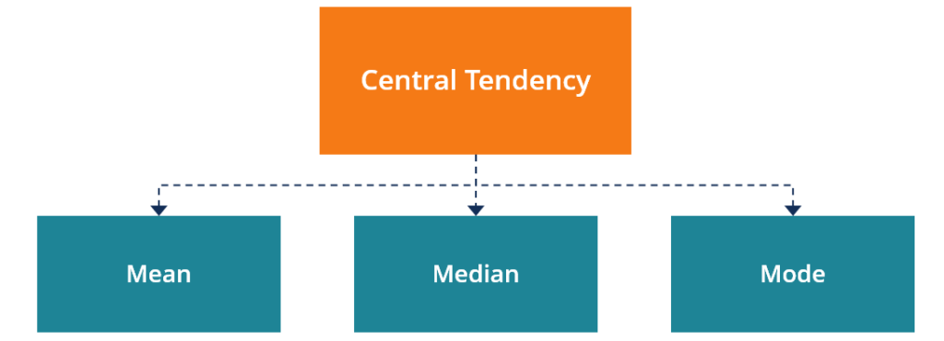
Measures of Central Tendency

Slide 35
Statistic Measures
Definition:
A measure of center is a value in the "middle" of a dataset.
Different ways of defining center of data
Arithmetic mean of a dataset
Add up all the values and then dividing it by number of data values.

Slide 36
Statistic Measures
Eg: Python code to find mean of data values
the average is 14.25 and
all the values are fairly close to it.
But what if we introduce a new value: 31?
greatly affects the mean because the arithmetic mean is sensitive to outliers.
The new value, 31, is almost twice as large as the rest of the numbers and, therefore, skews the mean.
Another, and sometimes better, measure of center is the median.
import numpy as np
np.mean([11, 15, 17, 14]) == 14.25
np.mean([11, 15, 17, 14,31]) == 14.25

Slide 37
Statistic Measures
Median
the number found in the middle of the dataset when sorted in order
Python code:
As seen introduction of 31 using the median did not affect the median of the dataset greatly.
because the median is less sensitive to outliers.
When working with datasets with many outliers, use the median of the dataset
while if your data does not have many outliers and the
data points are mostly close to one another, then the mean is likely a better option.
np.median([11, 15, 17, 14]) == 14.5
np.median([11, 15, 17, 14, 31]) == 15

Slide 38
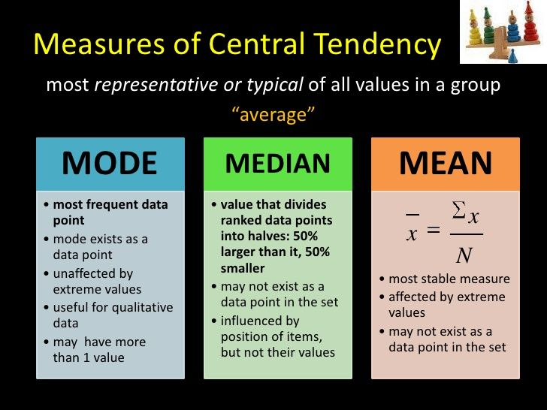

Slide 39
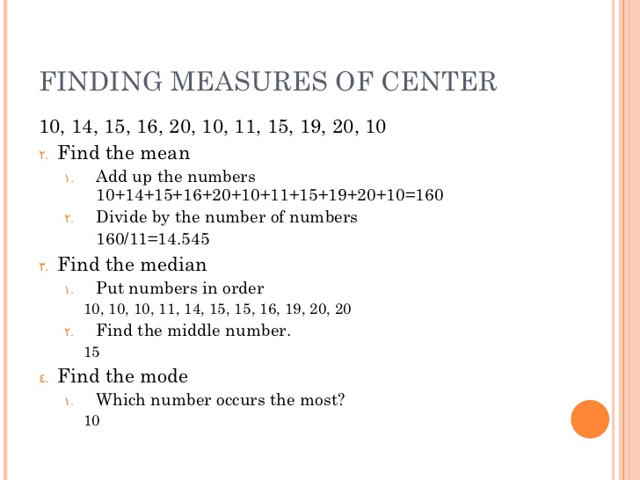

Slide 40
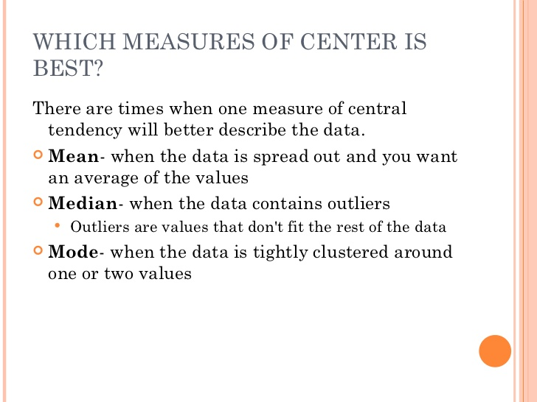

Slide 41
Measures of variation
But how can we tell if the data is spread out?
Measures of variation
Measures of center are used to quantify the middle of the data,
measuring how "spread out" the data we collect
Helps to identify if our data has many outliers lurking inside.

Slide 42
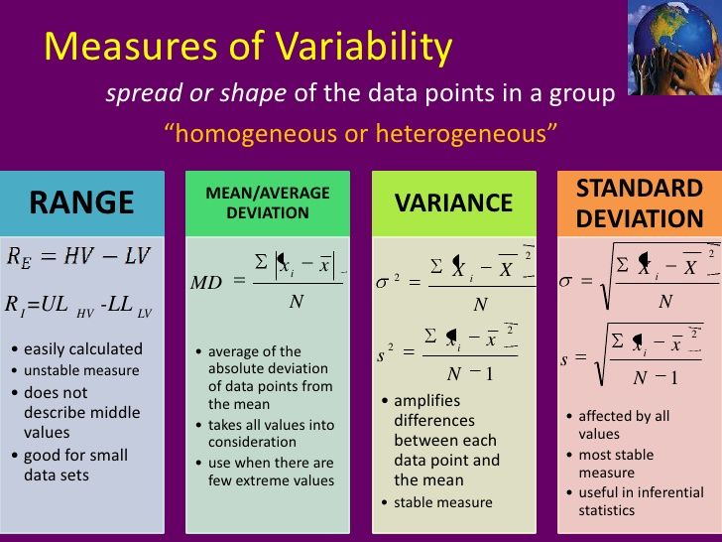

Slide 43
Measures of variation
Eg:
Consider that we take a random sample of 24 of our friends on Facebook
and wrote down how many friends that they had on Facebook.
friends = [109, 1017, 1127, 418, 625, 957, 89, 950, 946, 797, 981,
125, 455, 731, 1640, 485, 1309, 472, 1132, 1773, 906, 531, 742, 621]
np.mean(friends) == 789.1

Slide 44
Statistic Measures
Average of the list is 789
➔ according to the sample, average Facebook friend has 789
But what if a person has 89 friends or over 1600 friends.
Many of these numbers are not really that close to 789.
If we consider median since it is not affected by outliers
Fairly close to mean but still drastic variation with the data points
This is what statisticians call measuring the variation of data
np.median(friends) = 769.5

Slide 45
Measures of variation
Basic measure of variation – Range
Defined as the maximum value minus the minimum value, as illustrated:
tells us how far away the two most extreme values are.
typically, the range isn't widely used but it does have its use in application.
Sometimes we wish to just know how spread apart the outliers are.
This is most useful in scientific measurements or safety measurements.
np.max(friends) – np.min(friends) = 1684

Slide 46
Measures of variation
Eg:
Suppose a car company wants to measure how long it takes for an air bag to deploy.
Knowing the average of that time is good,
but they also really want to know how spread apart the slowest time is versus the fastest time.
This literally could be the difference between life and death.

Slide 47
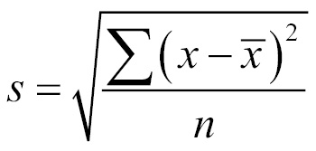
Measures of variation
Standard Deviation
denoted by s when working with a sample of a population,
measures how much data values deviate from the arithmetic mean.
It's basically a way to see how spread out the data is.
general formula to calculate the standard deviation, which is as follows:

Slide 48
Measures of variation
Where
s is our sample standard deviation
x is each individual data point.
is the mean of the data
n is the number of data points

Slide 49
Measures of variation
the number 425 represents is the spread of data.
➔ 425 is a kind of average distance the data values are from the mean.
it means, that this data is pretty spread out.
So, the standard deviation is about 425.
This means that the number of friends that these people have on Facebook doesn't seem to be close to a single number and
that's evident when the data is plotted in a bar graph
and also graph the mean
as well as the visualizations of the standard deviation.
np.std(friends) # == 425.2

Slide 50
Measures of variation
In the following plot,
every person will be represented by a single bar in the bar chart,
and the height of the bars represent the number of friends that the individuals have:
import matplotlib.pyplot as plt
%matplotlib inline
y_pos = range(len(friends))
plt.bar(y_pos, friends)
plt.plot((0, 25), (789, 789), 'b-')
plt.plot((0, 25), (789+425, 789+425), 'g-')
plt.plot((0, 25), (789-425, 789-425), 'r-')

Slide 51
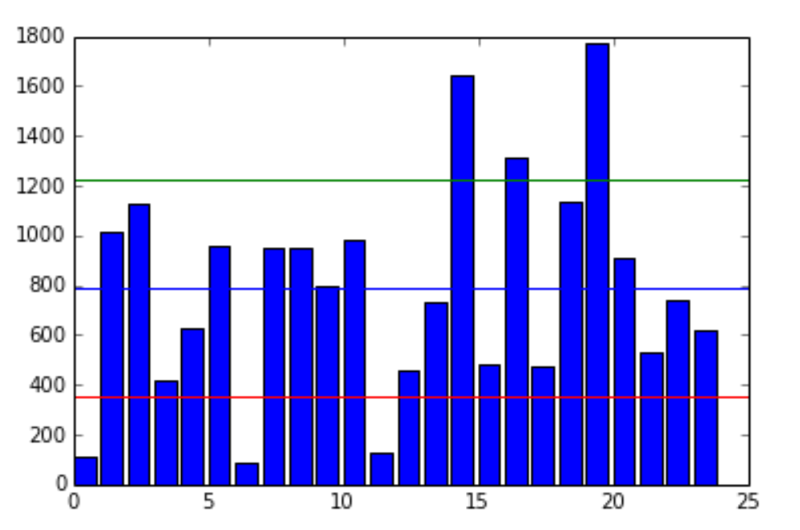
Measures of variation
In the following plot,
every person will be represented by a single bar in the bar chart,
and the height of the bars represent the number of friends that the individuals have:
import matplotlib.pyplot as plt
%matplotlib inline
y_pos = range(len(friends))
plt.bar(y_pos, friends)
plt.plot((0, 25), (789, 789), 'b-')
plt.plot((0, 25), (789+425, 789+425), 'g-')
plt.plot((0, 25), (789-425, 789-425), 'r-')

Slide 52
Measures of variation
The blue line in the center is drawn at the mean (789),
the red line on the bottom is drawn at the mean minus the standard deviation (789-425 = 364),
the green line towards the top is drawn at the mean plus the standard deviation
(789+425 = 1,214).
Note how most of the data lives between the green and the red lines
while the outliers live outside the lines.
Namely, there are three people who have friend counts below the red line
and three people who have a friend count above the green line.
the standard deviation and variance is good for checking how spread out the data is,
we can use it along with the mean to create a kind of range that a lot of our data lies in.

Slide 53
Measures of variation
The blue line in the center is drawn at the mean (789),
the red line on the bottom is drawn at the mean minus the standard deviation (789-425 = 364),
the green line towards the top is drawn at the mean plus the standard deviation
(789+425 = 1,214).
Note how most of the data lives between the green and the red lines
while the outliers live outside the lines.
Namely, there are three people who have friend counts below the red line
and three people who have a friend count above the green line.
the standard deviation and variance is good for checking how spread out the data is,
we can use it along with the mean to create a kind of range that a lot of our data lies in.

